Slide 1
Final Project Proposal
Karina Wu

Slide 2
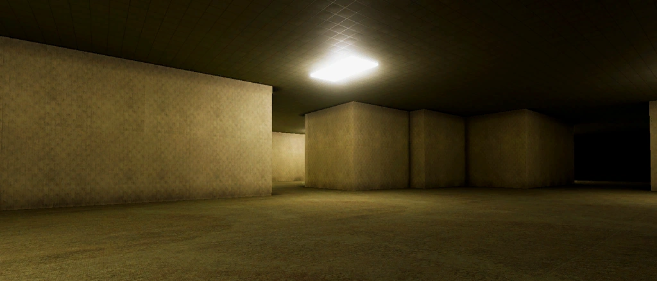
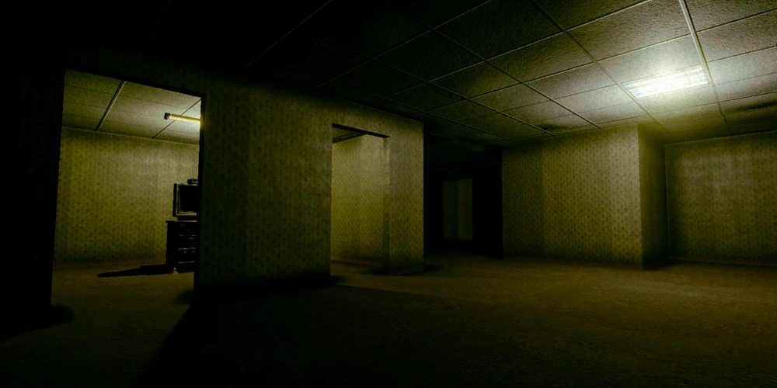
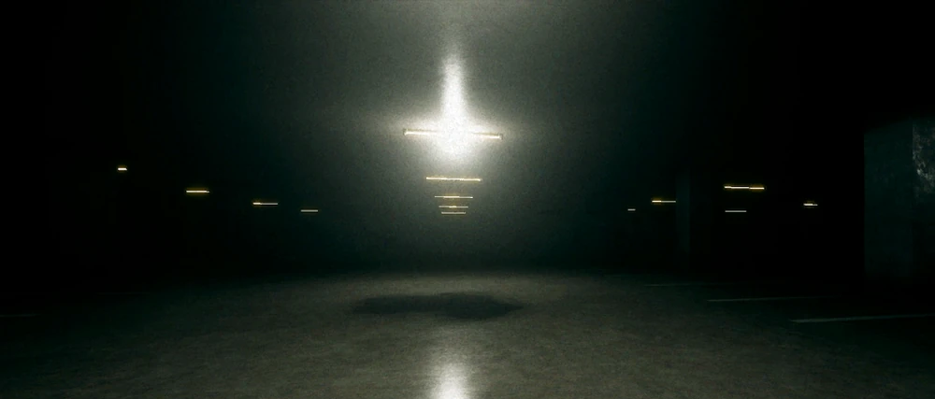
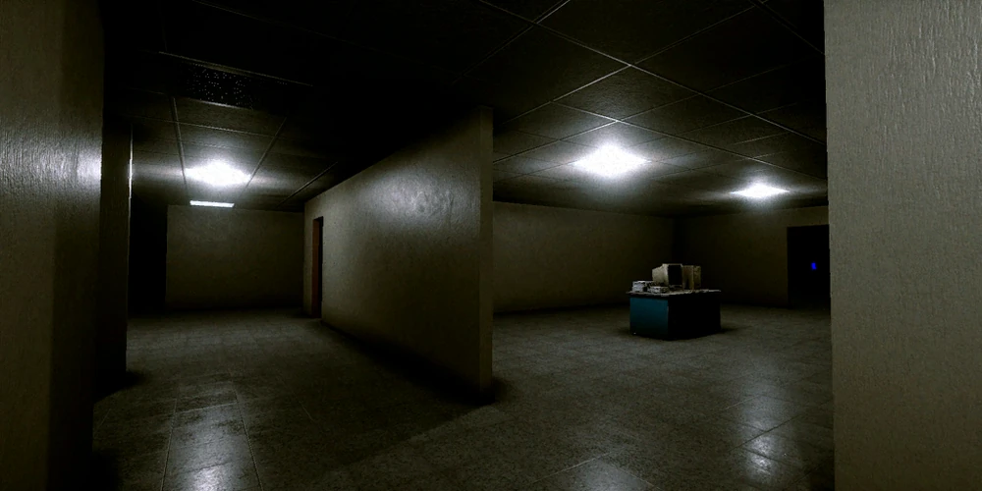
New Website Format
<header> <navbar>
<header> <navbar>
Dropdown when pressed
<img>
<info>
I’m going to be redesigning my midterm project with more elements, including javascript and bootstrap
← When the image is hovered, it’ll pop out (animate)

Slide 3
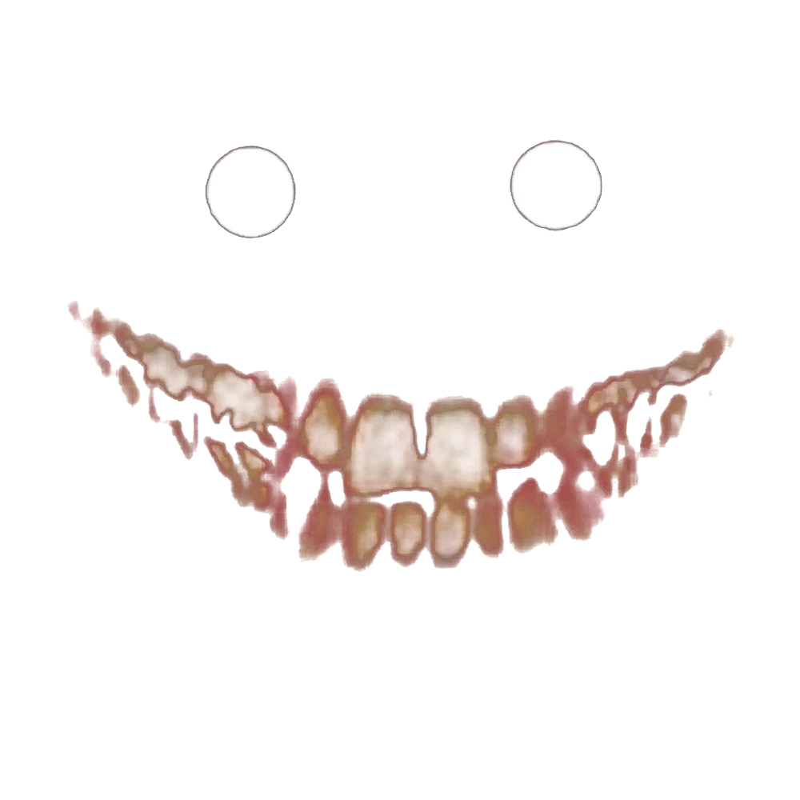
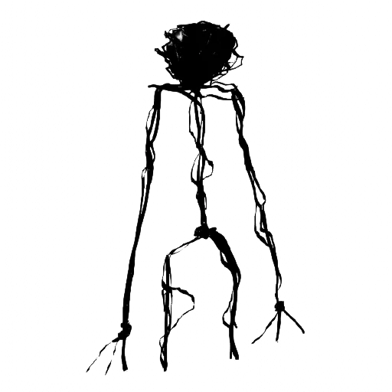
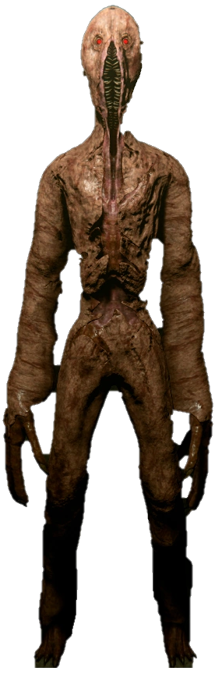
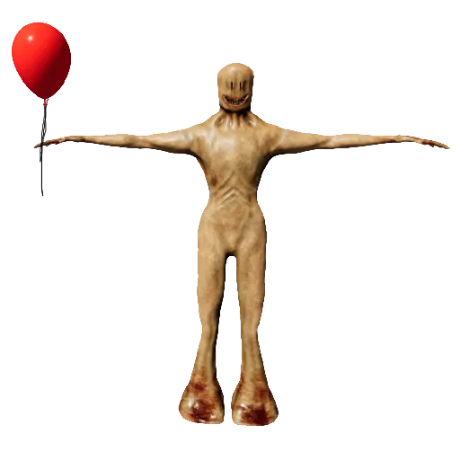
Javascript
Example →
If possible I want to randomly generate the monsters in the levels pictures whenever you refresh the page.
So, when you click on the monsters, it’ll send you to a page with more info of them.

Slide 4
Bootstrap
<navbar>
Levels
Entities
Items
Achievement
I’ll use bootstrap to do the information pages and the navbar.

Slide 5
To Do List
Links between pages within the website
Buttons
Media Queries (screen sizing)
Positioning
Box Model
HTML forms
Transitions and Transforms
Flexbox
Javascript (functions, DomContentLoaded)
Bootstrap (navbar, gallery, etc)

Slide 6
END

